Slide 1

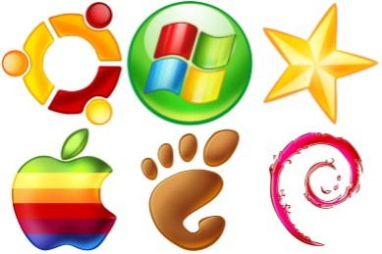
Overview of Virtualization
Telerik Software Academy
http://academy.telerik.com
The magic of virtual machines
Borislav Varadinov
Marian Marinov
System Administrator
CEO of 1H Ltd.
bobi@itp.bg
mm@1h.com

Slide 2


Table of Contents
What means Virtualization?
Hardware Virtualization
  Full Virtualization
  Paravirtualization
  How the modern OS works?
  Hardware assisted virtualization?
  OS Level and Application Virtualization

Slide 3
What Virtualization Means?
Virtualization is a term that refers to various techniques, methods or approaches of creating a virtual version of something
Hardware (Machine) Virtualization
OS-Level/Application Virtualization
And many others…
Notes:
Data virtualization, the presentation of data as an abstract layer, independent of underlying database systems, structures and storage.

Slide 4
Hardware Virtualization
Hardware virtualization refers to the creation of a virtual machine that acts like a real computer with own operating system and applications
The software that creates and manages the virtual machines is called a hypervisor or Virtual Machine Manager (VMM).
We also use the terms
  Guest OS
  Host OS

Slide 5
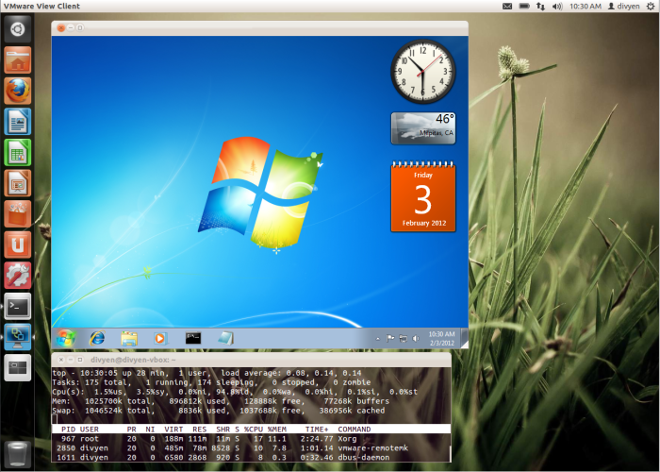
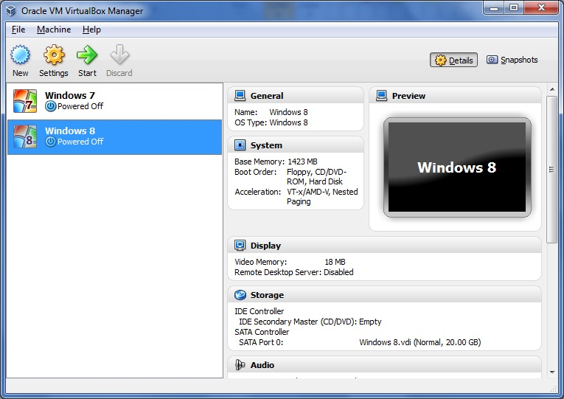
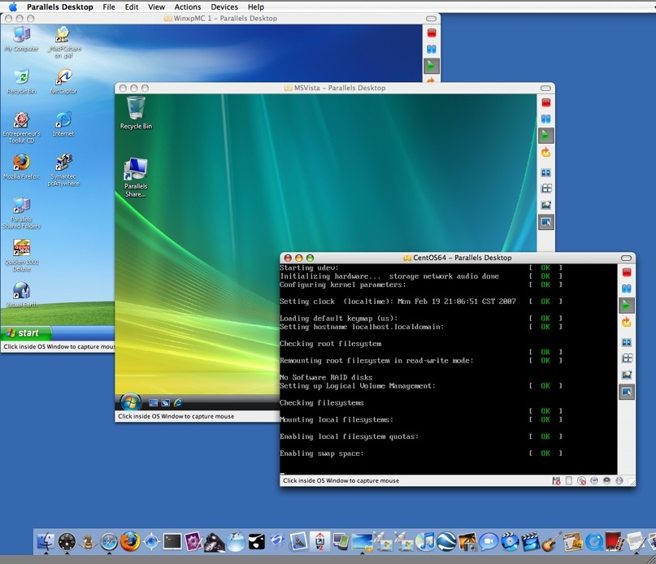
Desktop Virtualization

Slide 6





Virtual Desktop Infrastructure (VDI)
Hypervisor

Slide 7
Full Virtualization
Almost complete simulation of the actual hardware to allow software, which typically consists of a guest operating system, to run unmodified.
The guest OS is not aware it is being virtualized
The guest OS requires no modification
The Virtual Machine has all standard components
  Virtual processors
  Memory
  Network Adapters
  Virtual Disks

Slide 8
Paravirtualization
Paravirtualization is a form of virtualization in which the guests run a modified operating system
The guest OS is modified and all privileged instructions are replaced with direct calls to the hypervisior
The guest OS is aware that it is running on a hypervisor
The guest OS does not communicate directly with the hardware, but with the hypervisior

Slide 9
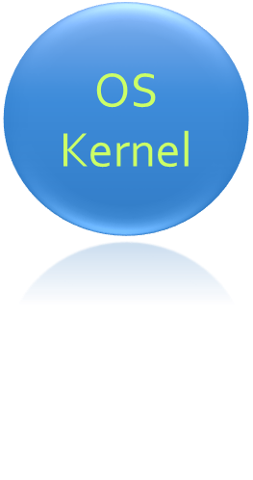
How the Modern OS Works?
4 Protection Levels
How can be virtualized that?
Applications
3
2
Isolation
1
0

Slide 10
Hardware Assisted Virtualization?
Today most Intel and AMD processors include hardware assisted virtualization
  (Intel-VT and AMD-V)
The technology was introduced in 2005 (Intel-VT)
The hardware assisted virtualization makes it possible to support unmodified guests
  without emulation and instructions translation

Slide 11


Hardware Assisted Virtualization?
VM1
VM2
Hypervisor
Ring - 1
Hardware

Slide 12
OS Level and
Application Virtualization
Chroot
Namespace isolation
  Network
  CPU
  Memory
  I/O
  Time
  Process/Thread

Slide 13
OS Level and
Application Virtualization
/ ------------------------ normal root
|-bin/
|-sbin/
|-usr/app1/ ----------- new root
|
|

Slide 14
Example of Virtualization Techniques
Full Virtualization
  VMWare ESXi
  Hyper-V
  KVM
  XEN
  Paravirtualization
    XEN
  OS-Level/Application

Slide 15
Virtualization
http://academy.telerik.com

Slide 16
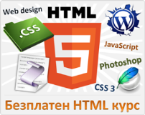



Free Trainings @ Telerik Academy
"Web Design with HTML 5, CSS 3 and JavaScript" course @ Telerik Academy
    html5course.telerik.com
  Telerik Software Academy
    academy.telerik.com
  Telerik Academy @ Facebook
    facebook.com/TelerikAcademy
  Telerik Software Academy Forums
    forums.academy.telerik.com

